Slide 1
Coca Cola Stock Live and Updated
Created by: Divya Krishnakumar
Type of project: Internship Project
Tools used: Python
Submitted to: Unified Mentor Pvt Ltd.
Date: 30/07/2025

Slide 2
Executive Summary
The aim of the project is to analyse and predict Coca Cola Stock price. The methodology followed involves the following steps: Data Collection, Data Analysis, Data Visualisation, Feature Engineering, Model building, Model Evaluation, Deployment.
Data is collected under the ticker ‘KO’ and loaded to a dataframe. The columns in the dataframe are – Date, Open, High, Low, Close, Volume, Dividends, Stock Splits. The data is checked for any null values. There were no null values. The data is analysed and visualised for stock attributes, close price trend, open price trend, stock split trend, distribution of dividends.
New features involving financial indicators such as moving averages, daily returns, volatility are created.
A RandomForestRegressor model is developed to predict close price. The model is evaluated using the metrics Mean Squared Error and R-Squared.
A web application is created using Streamlit of the entire analysis and predictions.

Slide 3
Introduction
The aim of the project is to analyse and predict Coca Cola Stock price(closing price). The stock data is live and updated.
The key questions are:
Trend of coca cola stock
Trend of close price
Trend of open price
Distribution of dividends over years
Distribution of stock splits over years
Distribution of volume over years
Trend of moving averages
Volatility of stock

Slide 4
Methodology
Data is collected from yahoo.finance under the ticker name ‘KO’.
The methodology adopted consists of following steps: Data Collection, Data Analysis, Data Visualisation, Feature Engineering, Model building, Model Evaluation, Deployment.
The collected data is analysed, visualised and subjected to machine learning algorithm such as RandomForestRegressor and evaluated.
Data Collection- Data is collected under the ticker name ‘KO’ and loaded to a dataframe. The columns in the dataset were Date, Open, High, Low, Close, Volume, Dividends, Stock Splits.

Slide 5
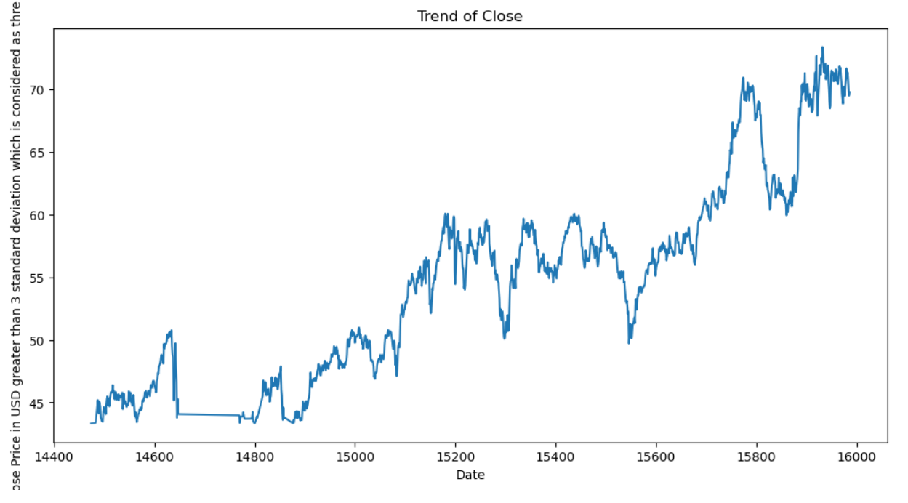
Data Analysis and Visualisation results
The trend of stock whether bullish or bearish
The stock shows a bullish trend from 2019-07-03 onwards.

Slide 6
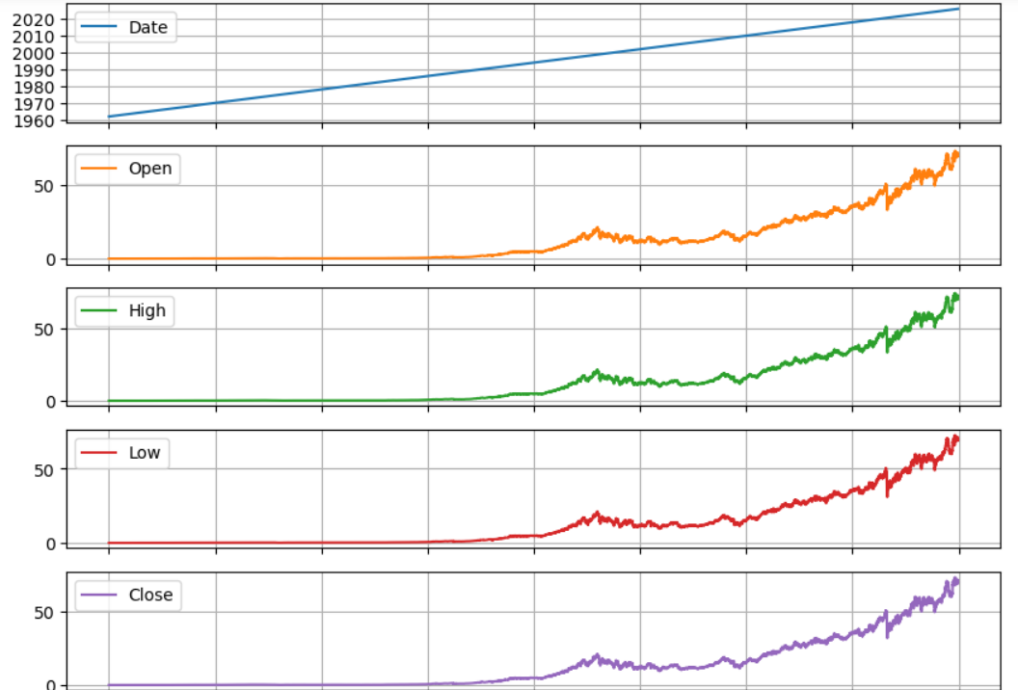
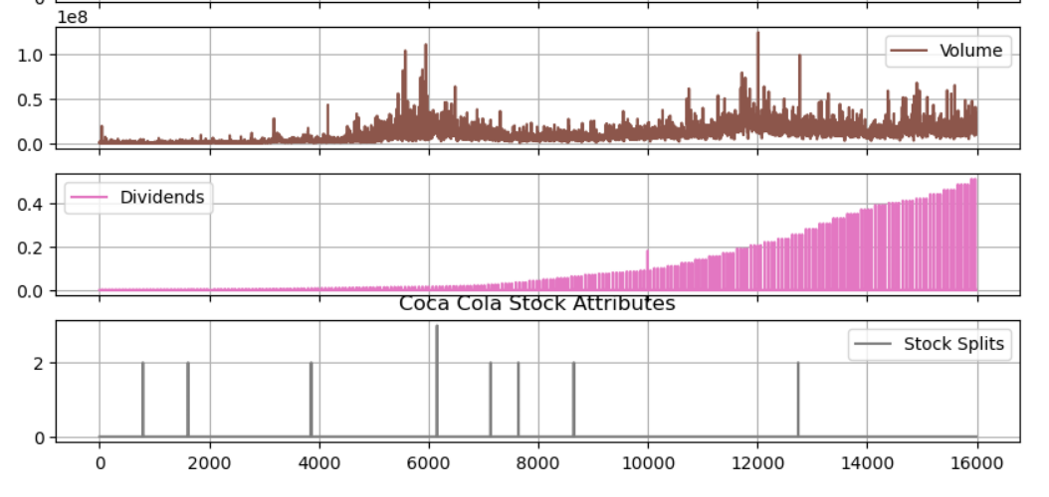
Data Analysis and Visualisation results
Coca Cola stock attributes

Slide 7
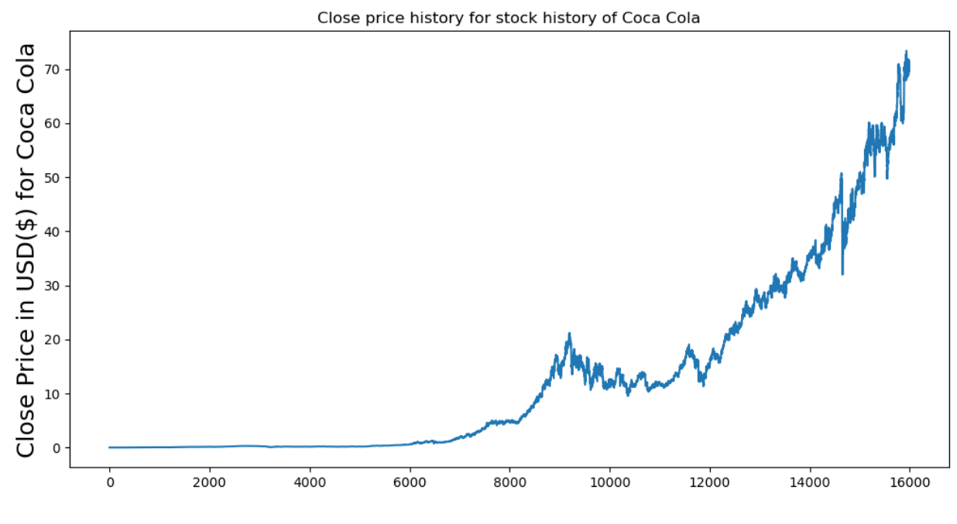
Data Analysis and Visualisation results
Close price trend

Slide 8
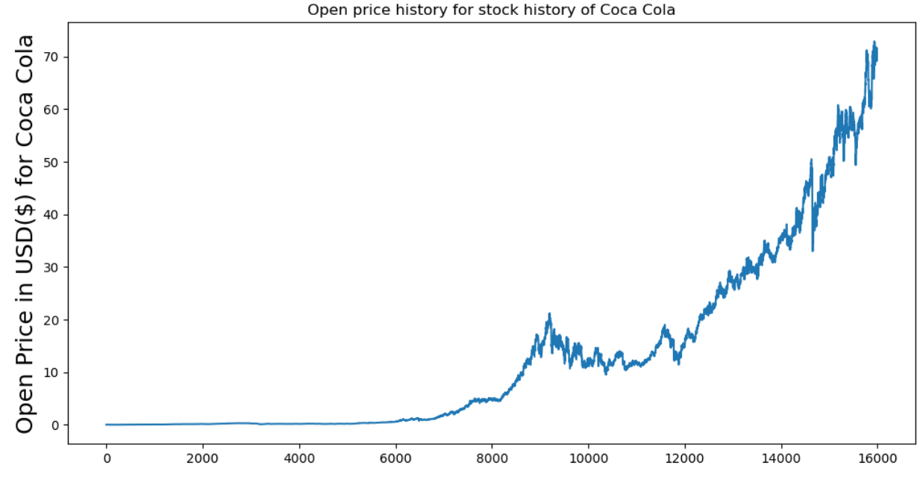
Data Analysis and Visualisation results
Open price trend

Slide 9
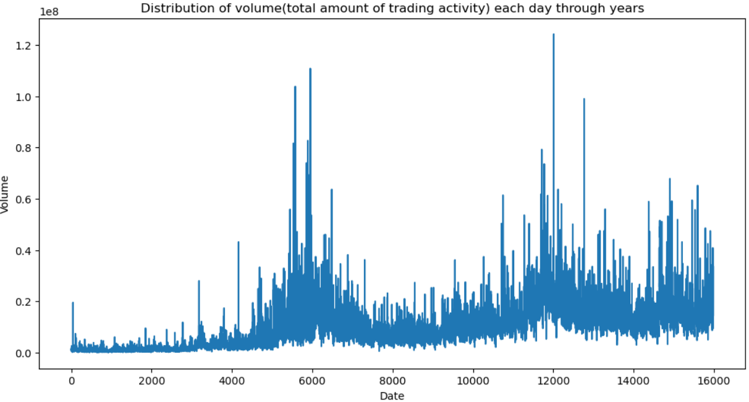
Data Analysis and Visualisation results
Distribution of volume through years

Slide 10
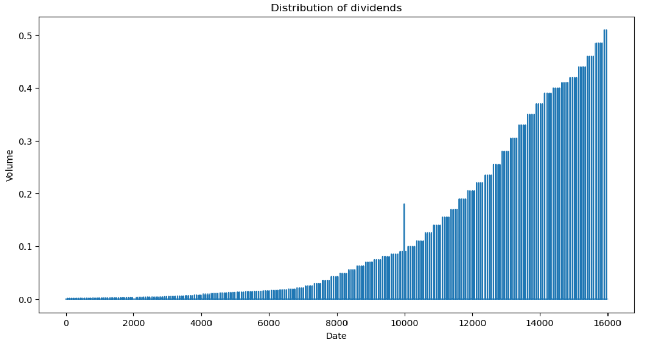
Data Analysis and Visualisation results
Distribution of Dividends
Distribution of dividends has increased over the years.

Slide 11
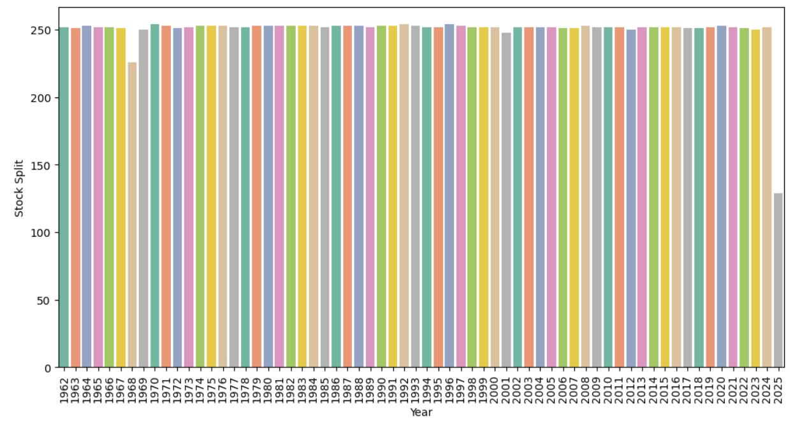
Data Analysis and Visualisation results
Stock splits trend
The stock splits follow a constant trend.

Slide 12
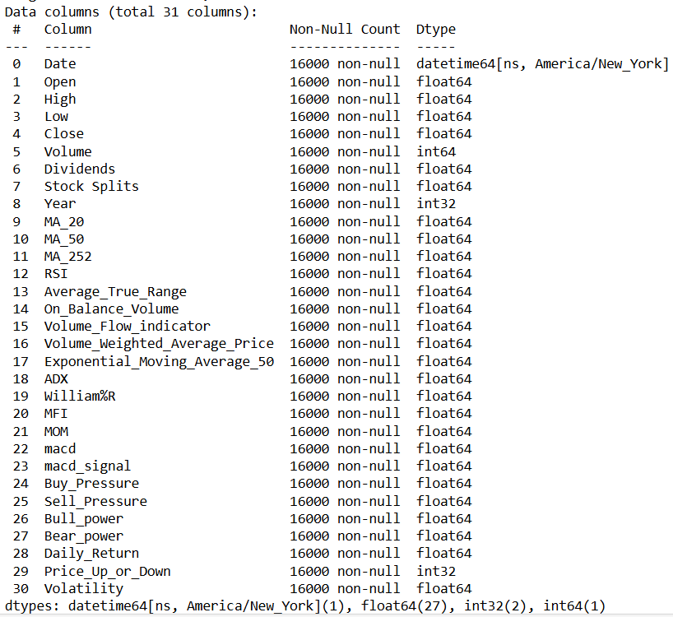
Feature Engineering
New features for financial indicators such as moving averages, daily return, bull power, bear power, average true range, volume flow indicator, buy pressure, sell pressure etc are created for further analysis of the stock . After feature engineering data frame consists of following features.

Slide 13
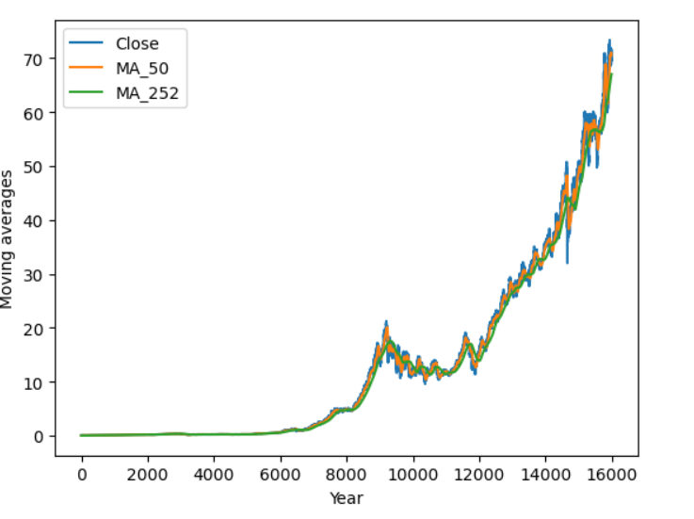
Data Analysis and Visualisation results
Moving averages trend

Slide 14
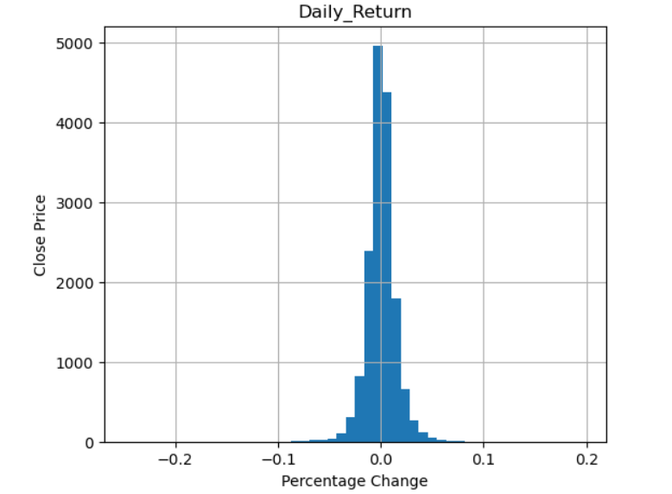
Data Analysis and Visualisation results
Distribution of percentage change in close price

Slide 15
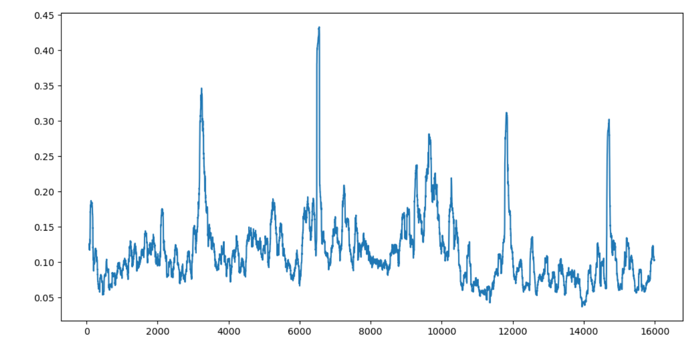
Data Analysis and Visualisation results
Is the stock volatile?
The stock is highly volatile.

Slide 16
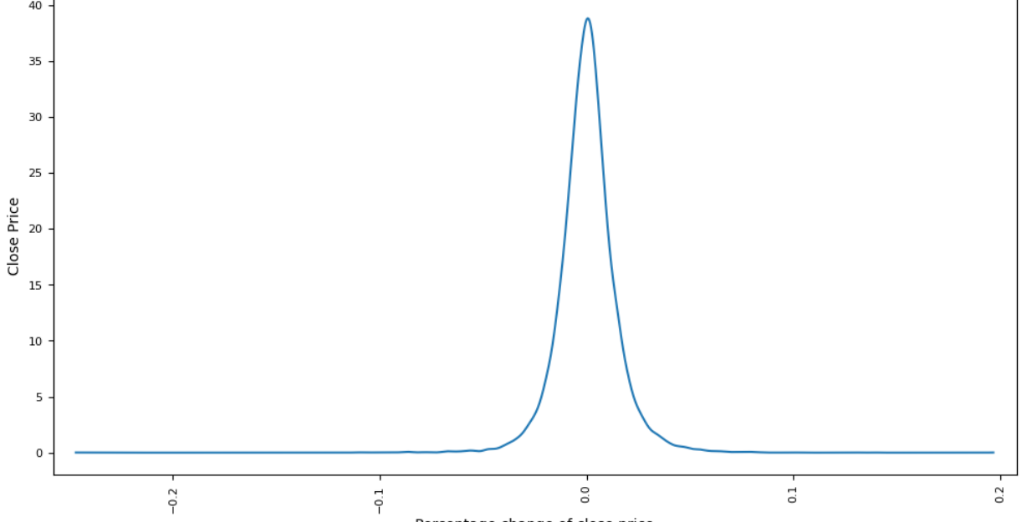
Data Analysis and Visualisation results

Slide 17
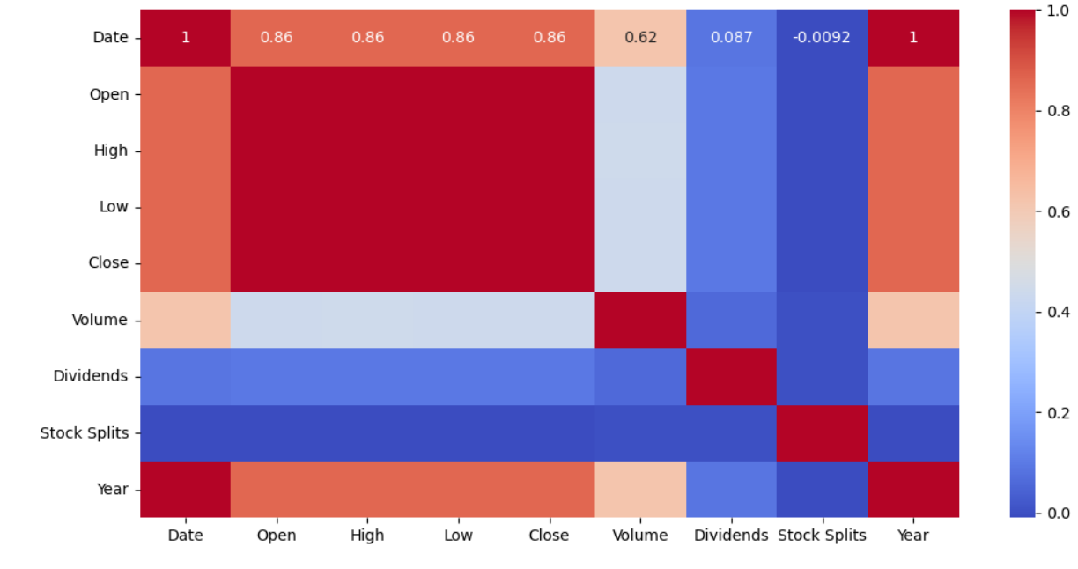
Data Analysis and Visualisation results
Correlation analysis

Slide 18
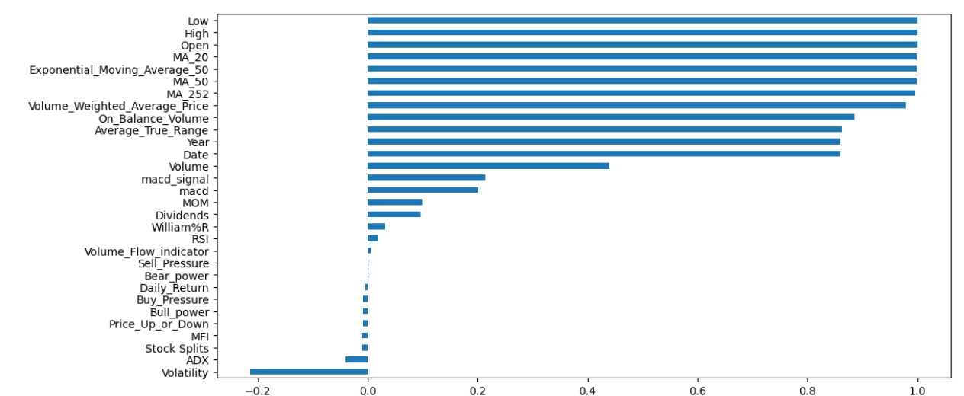
Feature importances visualisation

Slide 19
Model Building and Evaluation
The data is subjected to train-test-split with 20% test data. The dataset is subjected to machine learning algorithm RandomForestRegressor and a model initialised and fitted with training data and predicted the close prices.
Then the model is evaluated with the metrics mean squared error and R-squared. The results are as follows
The predicted results are saved in a .csv file.
Mean Squared Error is 0.01421544694827629
R² Score is 0.9999480991225451

Slide 20
Model Deployment
A web application is developed using Streamlit to display analysis and predictions and the application is launched in the web browser.

Slide 21
Findings and Implications
The trend of stock is bullish.
The closing price has increasing trend over the years with current closing price at 69.37.
The opening price has increasing trend over the years with current open price 68.33.
The volume has increased over the years with current volume 16215500.
The dividends distribution has increased over the years.
The stock split follows a constant trend.
The moving averages shows an increasing trend.
The stock is volatile.
The buy pressure is higher than sell pressure.

Slide 22
Conclusion
The coca cola stock’s open price, close price, dividends distribution has increased over the years.
The percentage change in close price is less.
The stock is highly volatile.
The stock’s bull power is higher than bear power.
The buy pressure is higher than sell pressure.
Thus, the coca cola stock has a bullish trend.
Future implications and suggestions
The stock will continue its bullish trend. For that the above trend should continue.

